Slide 1

Optimizing Neonatal Intensive Care Unit Patient Flow: Leveraging Expert
Systems for Efficient Bed Allocation and Real-Time Decision Support
Osvaldo Mercado
BMIN 5200
https://github.com/ozziemercado/BMIN5200_Final_Project

Slide 2

Background
Allocation of pediatric beds within a hospital is a complex process
Patient flow is crucial in allocating the movement of patients through a facility from admission to discharge
Poor bed management and high census times causes ICU strain
Increased mortality
Increased patient disparities
High infection rates
Manasvini Singh and Atheendar Venkataramani. Capacity strain and racial disparities in hospital mortality.National Bureau of Economic Research, 2022.

Slide 3

NICU Characteristics
CHOP is a level IV NICU
Surgical, subspecialty and ECMO available
104 bed unit
Average census ~100 patients
Turnover 5-10 beds a day
NICU Medical Command responsible for bed flow
NICU continues to use pen and paper with an Excel sheet for bed flow communication

Slide 4
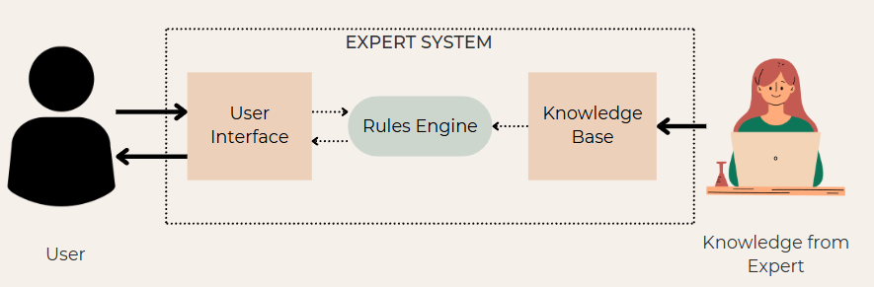
Expert System
Propose a rule-based expert system tailored toward NICU patient flow management
Ideal goal: EHR, Qgenda, and the expert system real-time integration

Slide 5
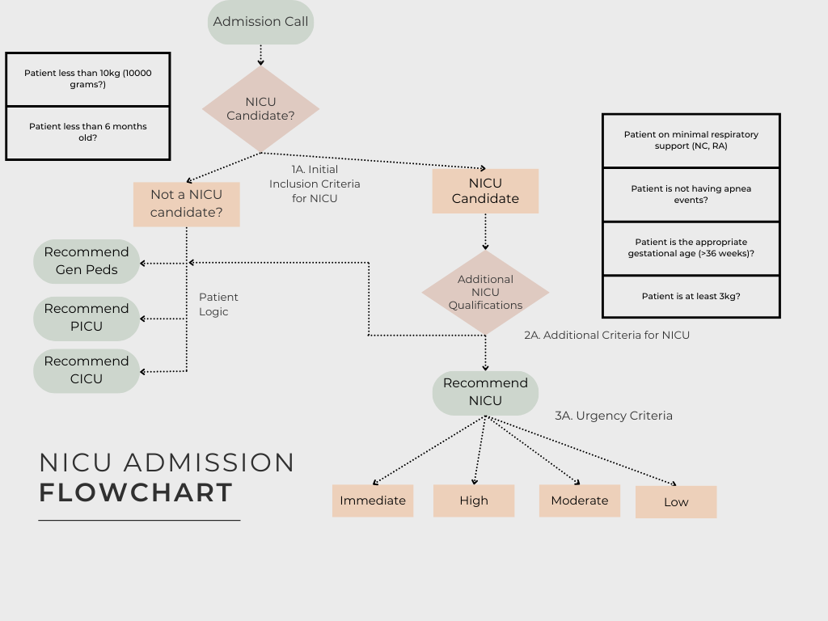

Slide 6

CLIPSPY Demonstration

Slide 7

CLIPSPY Demonstration

Slide 8

CLIPSPY Demonstration

Slide 9

CLIPSPY Demonstration

Slide 10
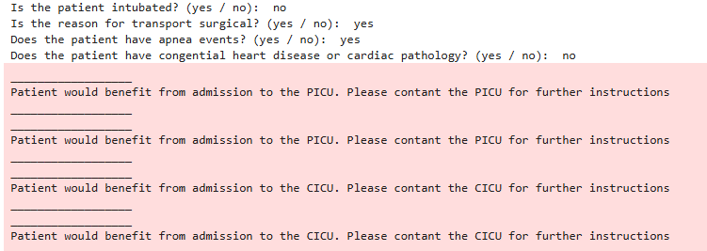
Lessons Learned and Troubleshooting
Chaining rules is challenging
Use discrete, well-defined values.
Capitalization errors caused issues
Renaming rules/templates risked breaking the system
Missed updates often broke functionality.

Slide 11

Conclusions
Expert systems can be utilized to create robust clinical decision support systems to guide users
Future goals:
Integration of real-time patient and census data and advanced algorithms (e.g. Breadth-first, A*) could have the potential to drastically help bed management
Thank you!!

Slide 12
References
Bruce G Buchanan and Reid G Smith. “Fundamentals of expert systems”. In: Annual review of computer science3.1 (1988), pp. 23–58.
Shan Carter and Michael Nielsen. “Using artificial intelligence to augment human intelligence”. In: Distill 2.12(2017), e9.
NEJM Catalyst. “What Is Patient Flow?” In: Catalyst Carryover 4.1 (2018). DOI: 10.1056/CAT.18.0289.eprint: https : / / catalyst . nejm . org / doi / pdf / 10 . 1056 / CAT . 18 . 0289. URL: https ://catalyst.nejm.org/doi/full/10.1056/CAT.18.0289.
Won Chul Cha et al. “The association between crowding and mortality in admitted pediatric patients from mixedadult-pediatric emergency departments in Korea”. In: Pediatric emergency care 27.12 (2011), pp. 1136–1141.
Melissa Chan, Garth Meckler, and Quynh Doan. “Paediatric emergency department overcrowding and adversepatient outcomes”. In: Paediatrics & child health 22.7 (2017), pp. 377–381.
Fatema Mustansir Dawoodbhoy et al. “AI in patient flow: applications of artificial intelligence to improve patient flow in NHS acute mental health inpatient units”. In: Heliyon 7.5 (2021).
Candadian Agency for Drugs and Technologies in Health. Artificial Intelligence for Patient Flow: EmergingHealth Technologies. Ottowa: Candadian Agency for Drugs and Technologies in Health, 2024. URL: https://www.ncbi.nlm.nih.gov/books/NBK604824/.
Humber River Health Foundation. “The Future of Emergency Medicine at HRH: How Virtual Queuing WillImprove Care”. In: (2024). URL: https://www.hrhfoundation.ca/blog/apotex-emergency-department-at-hrh/.
Scott D Halpern. “ICU capacity strain and the quality and allocation of critical care”. In: Current opinion incritical care 17.6 (2011), pp. 648–657.
Manasvini Singh and Atheendar Venkataramani. Capacity strain and racial disparities in hospital mortality.National Bureau of Economic Research, 2022.

